Slide 1
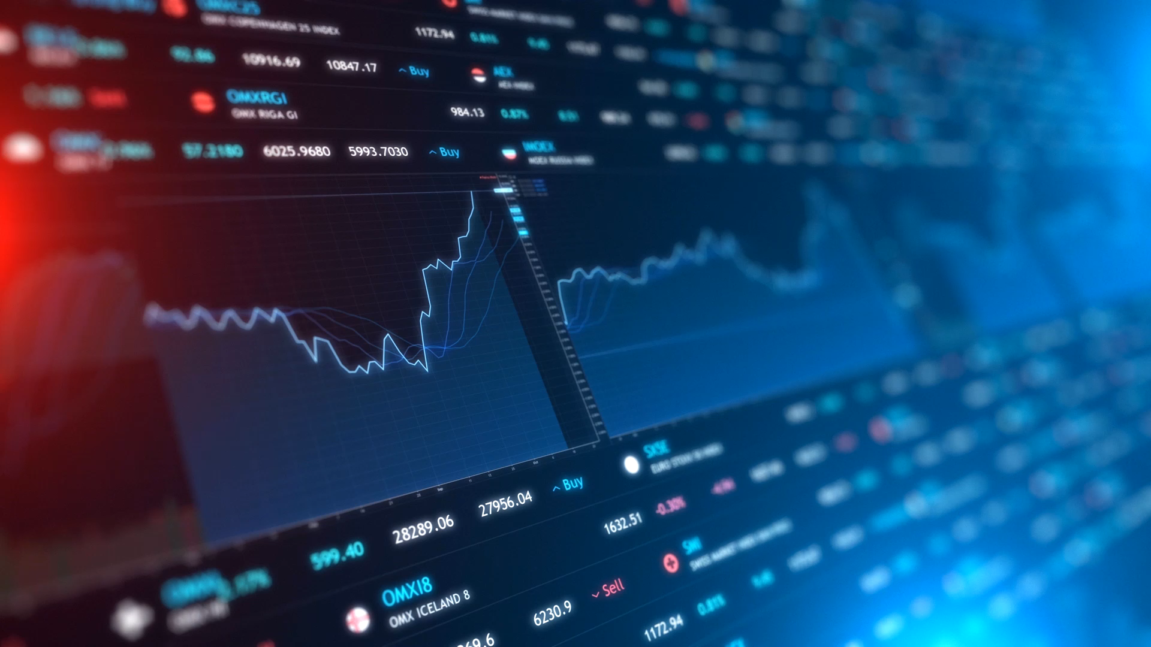
Applications of a Stock Market Predictor
Elayne Blancas: Team Manager
Gregory Perez: Programming Manager
Jonathan Zamudio: Resource Manager

Slide 2
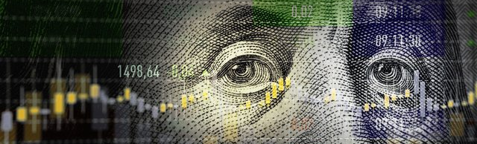
Stock Market
How does it work?
What is day trading?

Slide 3
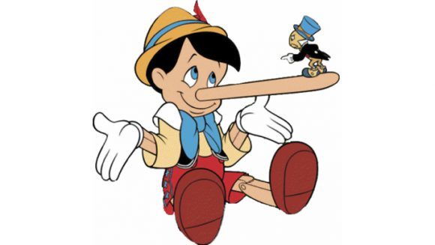
Two Truths and One Lie
Stocks indicate how valuable investors think a company is.
The stock market is the economy.
Stocks provide the capital for companies to gain a competitive advantage.

Slide 4

Background Information
S&P 500
Open
Close
Short
Long
Sharpe Ratio
Risk Return
Trends
Notes:
The open and close values of a stock are used to train the model. The dates is used as an index for the output values. We return the long and short (how do we get these exactly?)
Mean of long & short.
Sharpe ratio- average return minus risk-free return divided by stdev of return

Slide 5
99 problems but a stock ain’t one
Have a stock portfolio
Make performance predictions based on sequences of stock data
Implement investment strategy using predictions:
Go long on the top 10 companies
Go short on the flop 10 companies

Slide 6




Applications of Our Stock Market Predictor
To predict whether an individual stock will either overperform or underperform
To calculate the long and short gains of the portfolio’s stocks
To obtain the portfolio’s stocks average return and Sharpe Ratio
Notes:
Merge this with 5

Slide 7
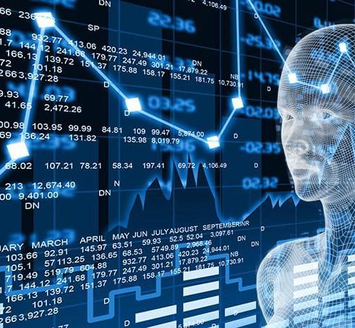
Data Acquisition
Used yfinance API to obtain a decade of daily historical stock data from Yahoo Finance for the top 30 S&P 500 companies
Labels include date, open, and close

Slide 8
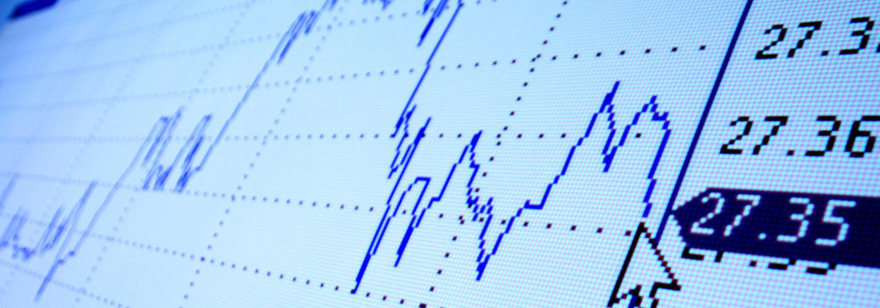
Exploratory Data Analysis
Data is non-negative stock values with no upper bound
It includes weekdays and non holidays

Slide 9
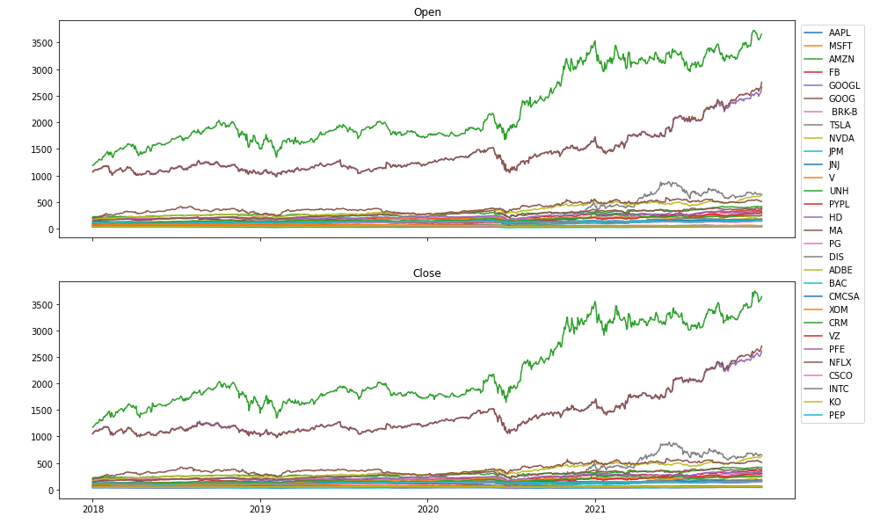
All 30 S&P 500 Companies Actual Open/Close from
2018-2021
Notes:
Shows how stocks are pretty much stable throughout a day, there isn’t drastic change over one day. It usually takes years to see big rises/dips in stock prices. In order to get a more accurate prediction, we had to use more data which is why we chose 10 years of historical stock data for our predictions. (sanity check)

Slide 10
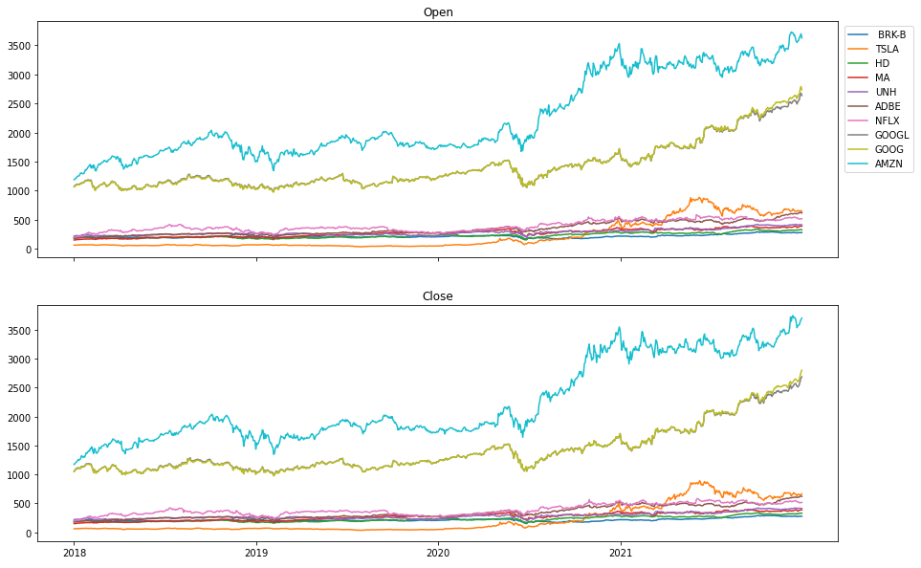
Top 10 Based on Average Price

Slide 11
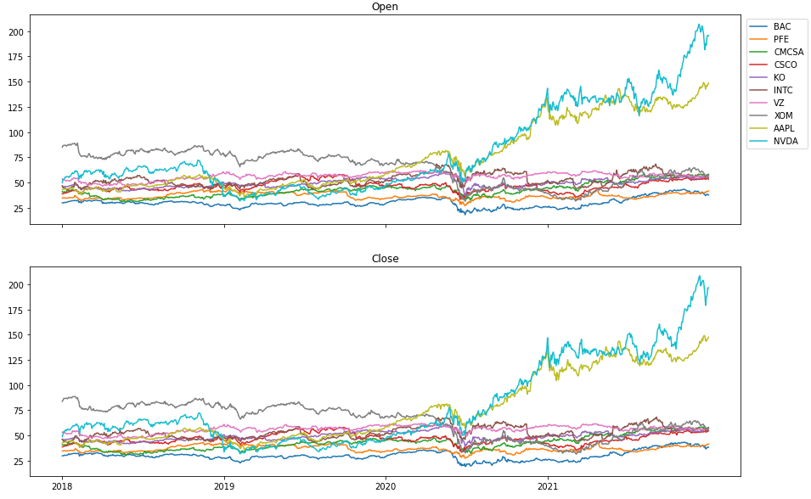
Flop 10 Based on Average Price

Slide 12
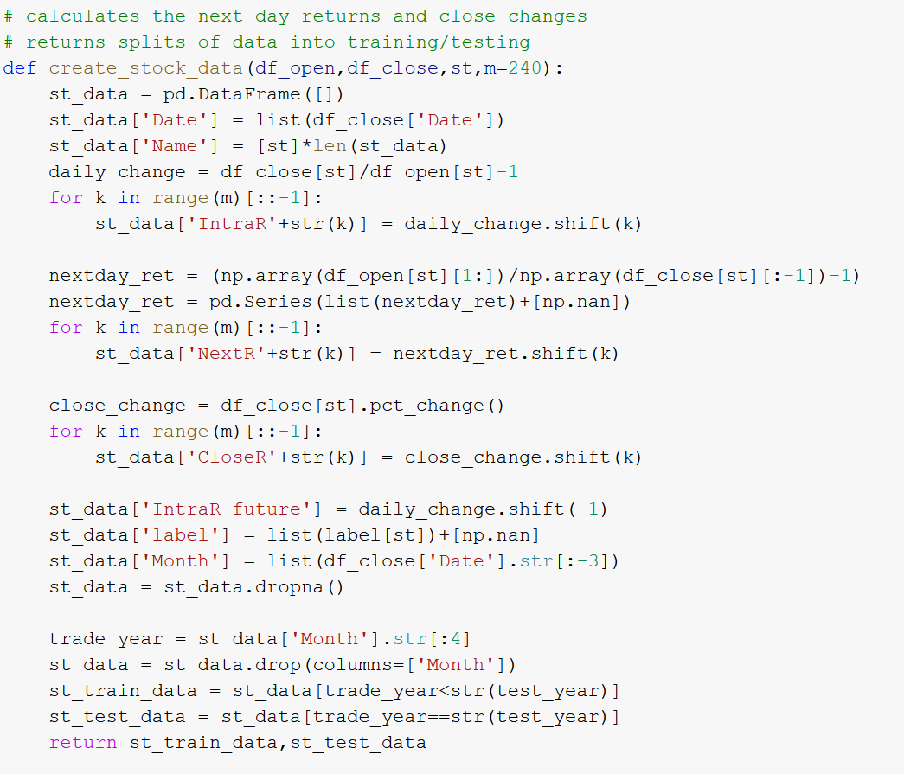
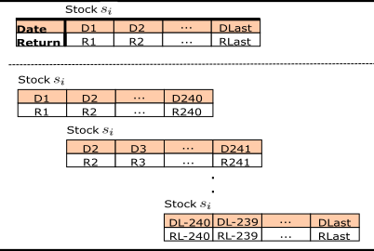
Processing & Splitting Data
Notes:
The splitting of our data into training and testing datasets. *** TIME SERIES DATA

Slide 13
Which Model Should We Choose?
Models | Advantages | Disadvantages
Logistic Regressor | High ability to tackle complex nonlinear patterns | Sensitive to outliers; strong assumptions
K Nearest Neighbor | Good against noisy data; efficient for large training datasets | Number of nearest neighbors must be predetermined; computationally expensive
Recurrent Neural Network | Useful for showing time relationships between input/output | Difficult to train
Support Vector Machine | Can provide optimal global solution; excellent predictive accuracy | Sensitive to outliers; sensitive to parameter selections
Random Forest | Various decision trees; automatically handles missing values | Uses more computational power and resources; requires more time to train
Long Short-Term Memory (LSTM) | Self-learning processes to analyze interactions and patterns; good at remembering information | Lacks mechanism to index memory while writing and reading data
Notes:
Random forest is our base line. We use it because:
State of the art machine learning model that requires virtually no tunnint and usually delievers good results
Commonly used method of choice across our research – a large scale machine learning application on monthly stock marter data
Random forest is a powerful benchmark for any innovative machine learning model
LSTM chosen because good for time series data

Slide 14
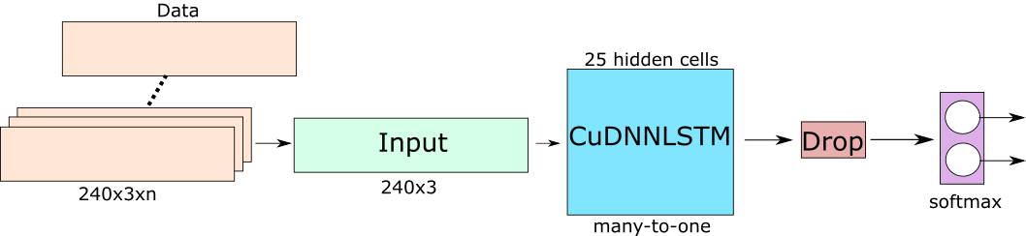
LSTM Model Architecture
Explain 240 (sequence of feature data) and 3 (features)

Slide 15
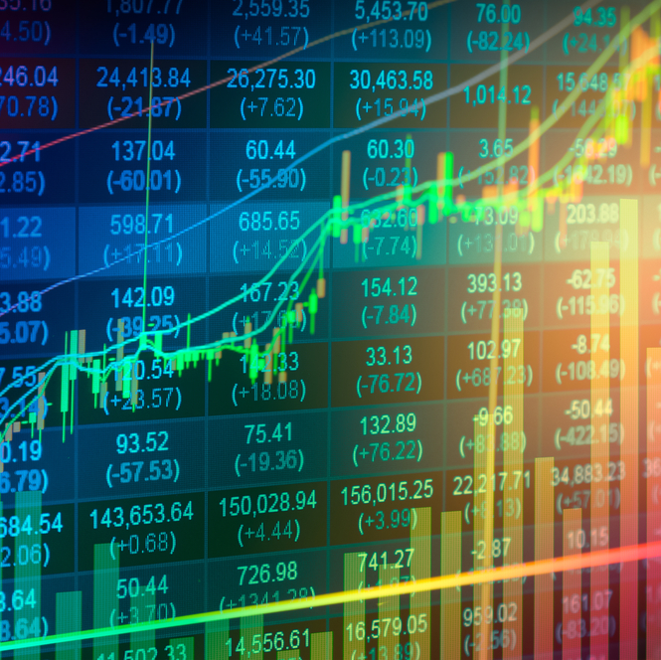
Results and Analysis

Slide 16

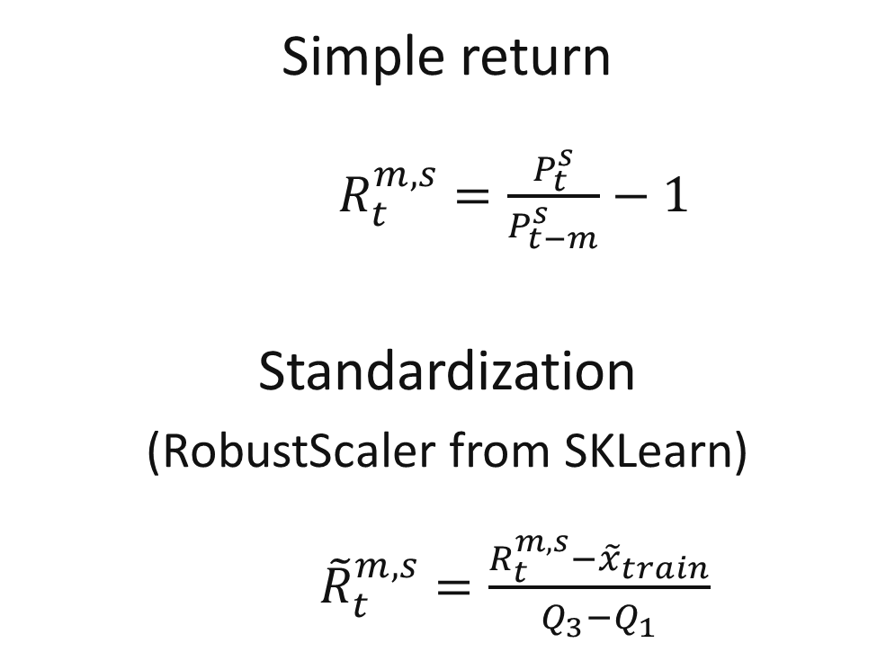
Calculations
Notes:
Add Sharpe Ratio here

Slide 17
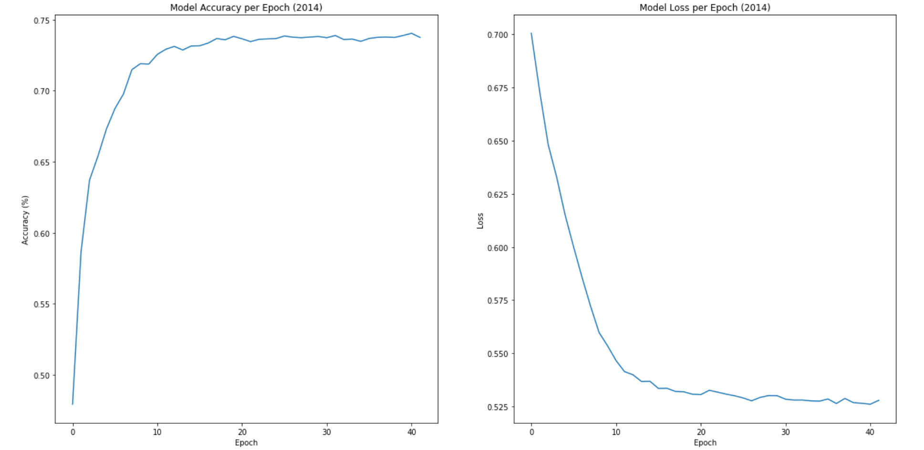
Training Model Performance
Notes:
Lots of oscillation in the accuracy and loss from 2020.
Ways to fix: decrease learning rate, more data, larger dropout rate, tune hyperparamters

Slide 18
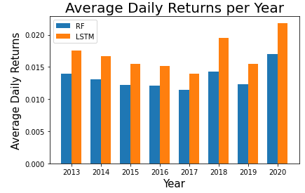
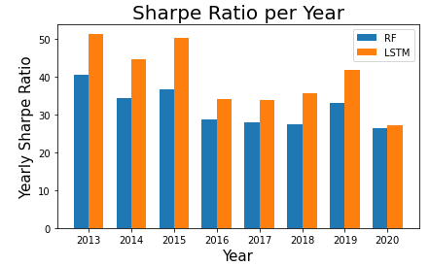
Average Difference: .373%
Average Difference: 8.35
Notes:
Comparing Perofrmance of our model against out benchmark
RF predictions are a bit off – LSTM is more accurate; percentage return

Slide 19
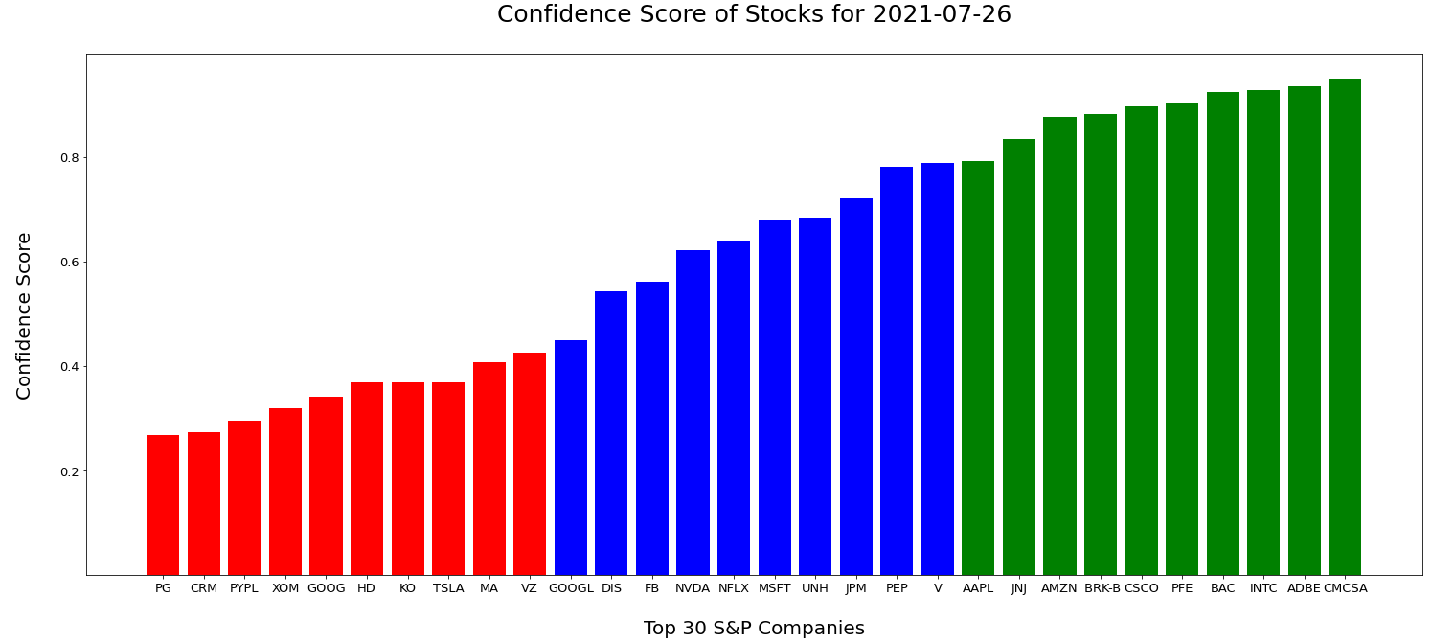

Slide 20

Conclusion
Our stock market predictor uses Random Forest as a baseline for our LSTM model producing a 60% - 70% training accuracy.
Our predictor would advise for a long investment on either Comcast Company or Adobe, and a short investment on either Procter & Gamble Company or Salesforce.
Our future work would be to include sentimental analysis, web scraping, and Beautiful Soup.
Notes:
performance gain LSTM to RF

Slide 21

Resources
https://www.kdnuggets.com/2018/11/keras-long-short-term-memory-lstm-model-predict-stock-prices.html
https://www.dezyre.com/recipes/what-is-difference-between-gru-and-lstm-explain-with-example
https://www.thebalance.com/how-do-stocks-and-stock-investing-affect-the-u-s-economy-3306179
https://eprints.soton.ac.uk/437785/1/FEMIB_2020_6.pdf
https://github.com/pushpendughosh/Stock-market-forecasting
https://colah.github.io/posts/2015-08-Understanding-LSTMs/
https://www.investopedia.com/terms/s/stockmarket.asp

Slide 22



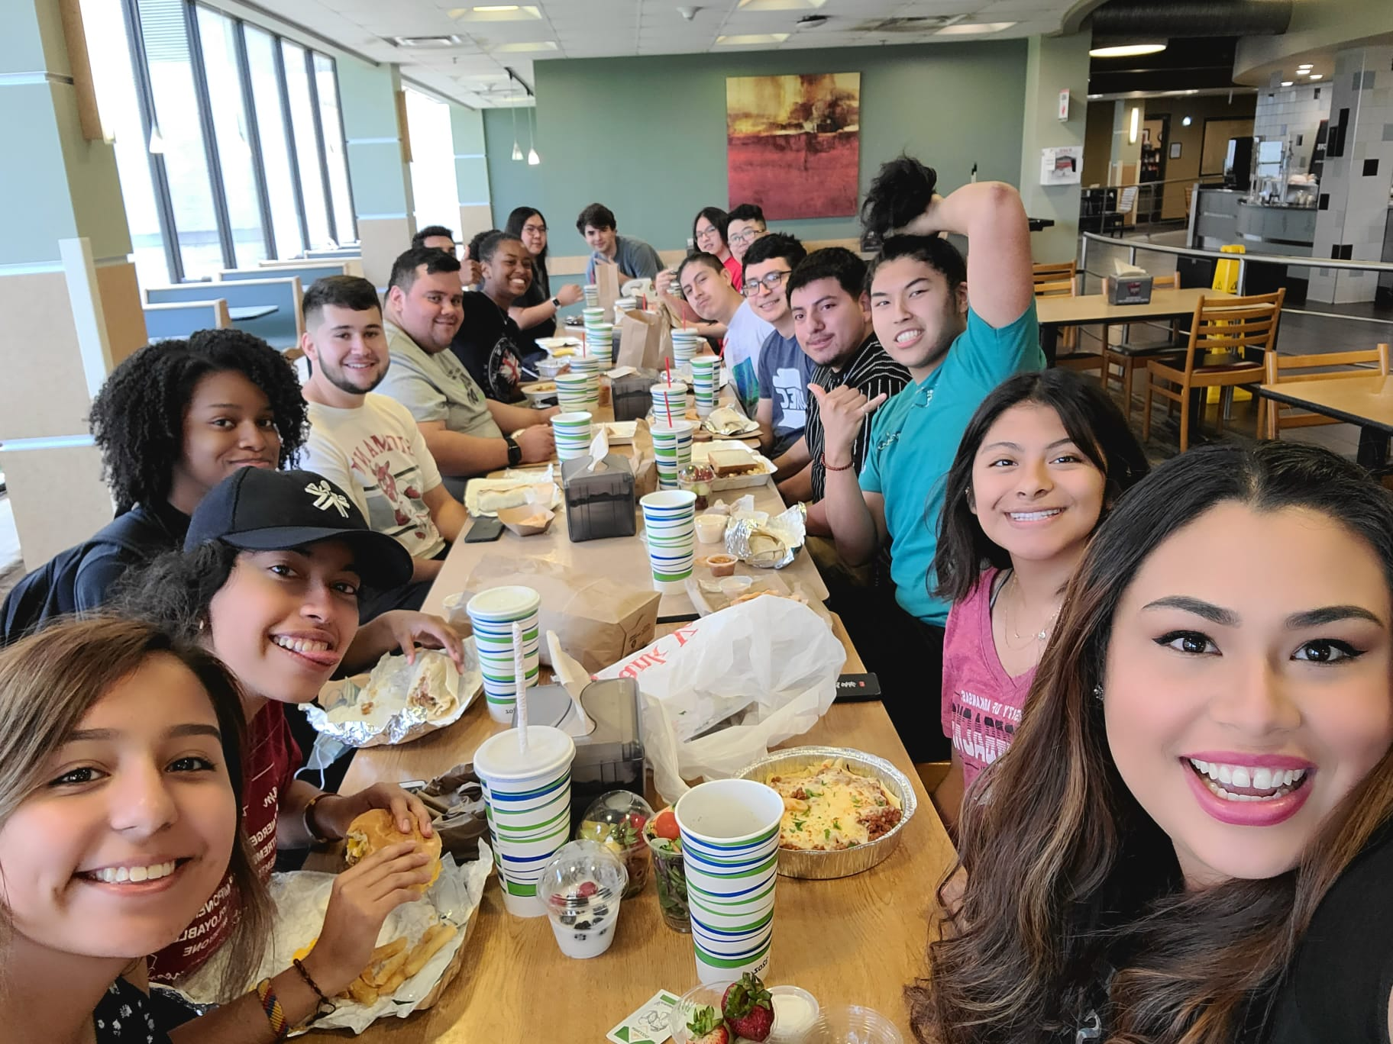
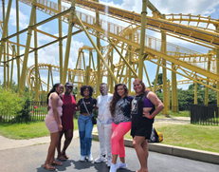
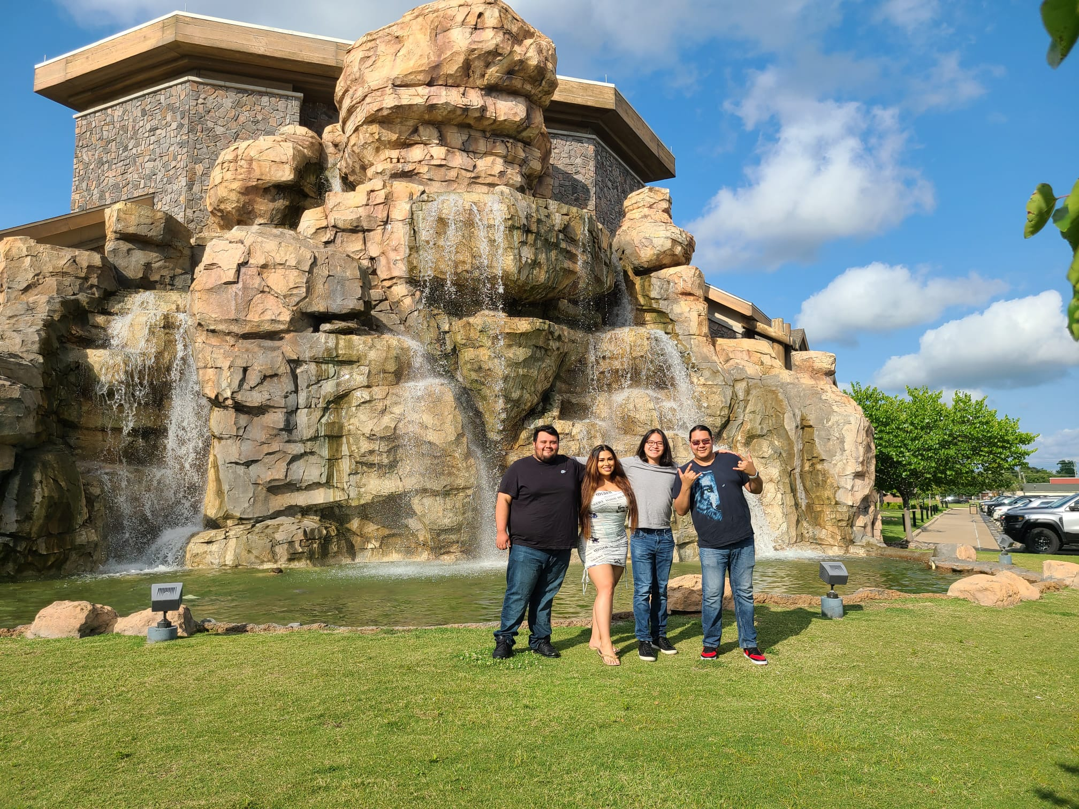
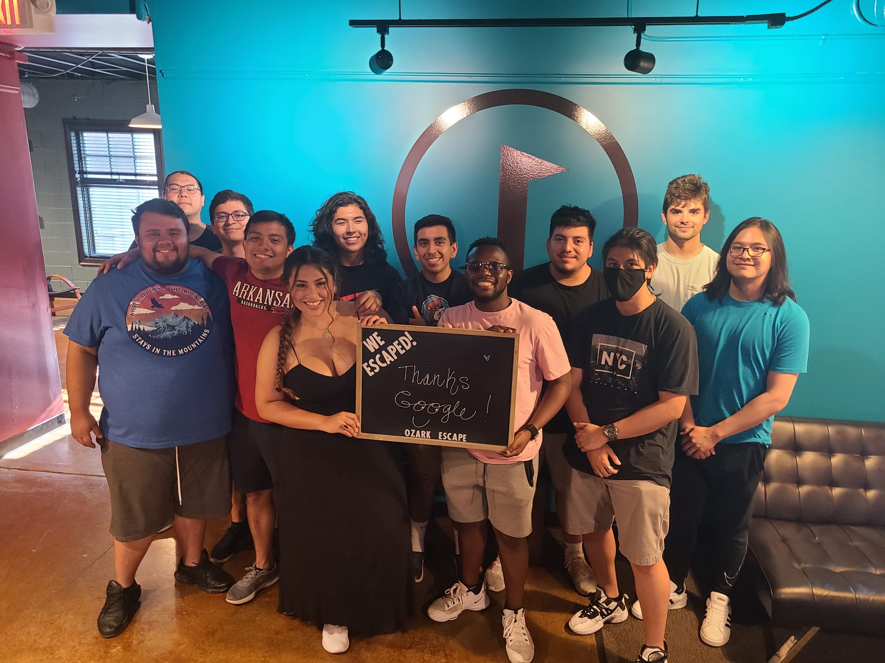
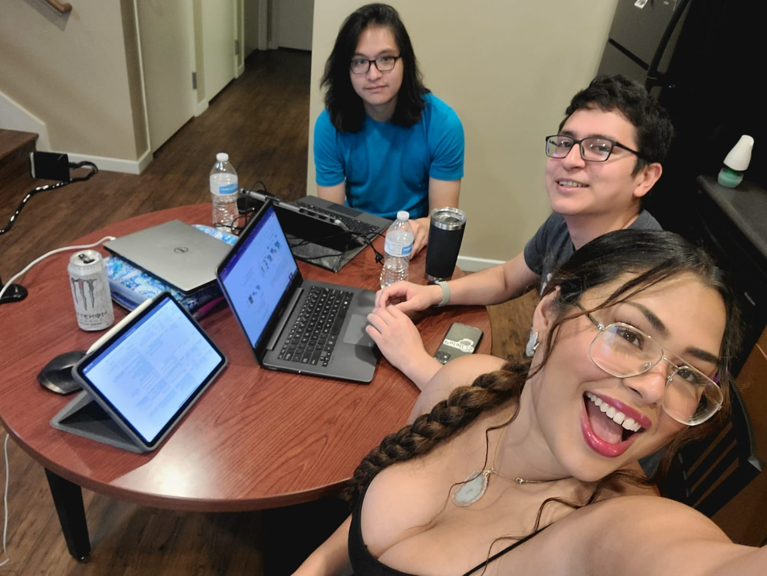
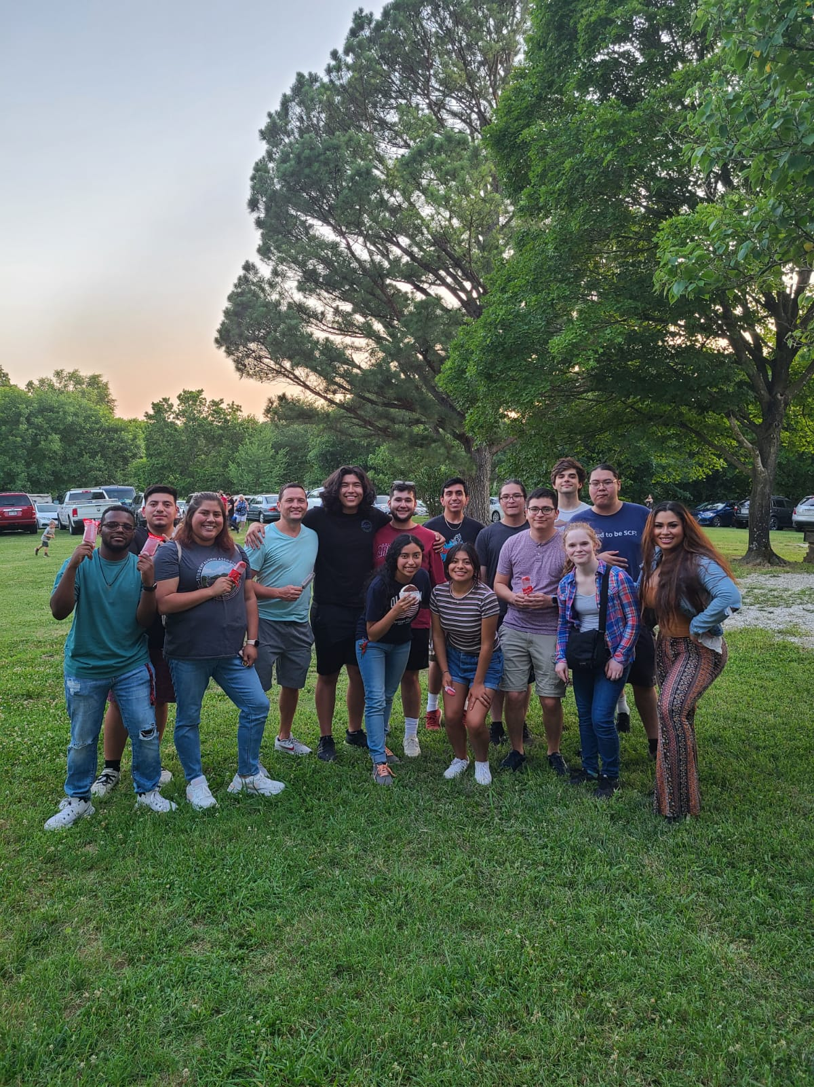
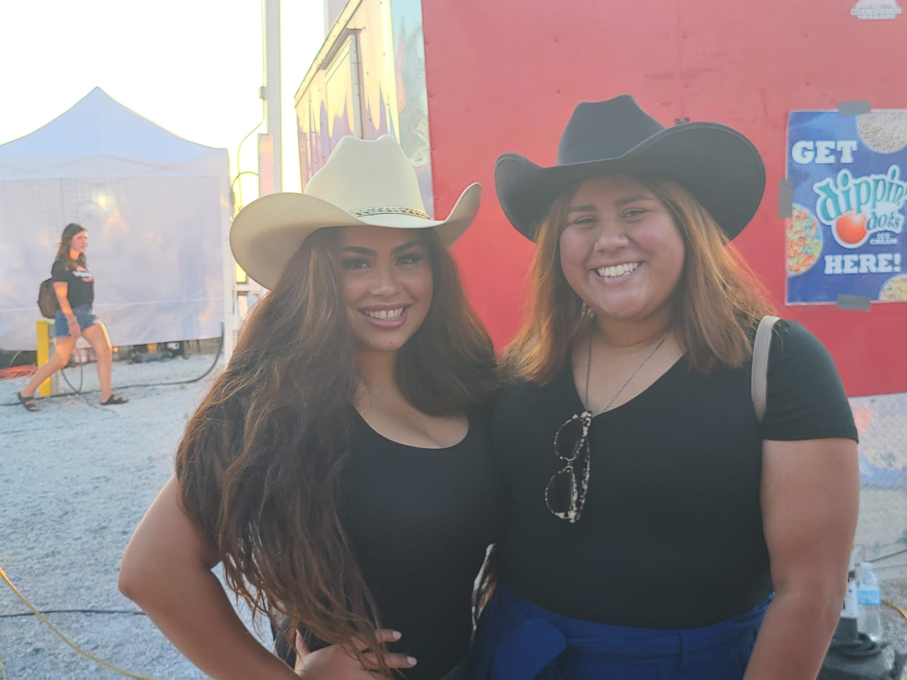
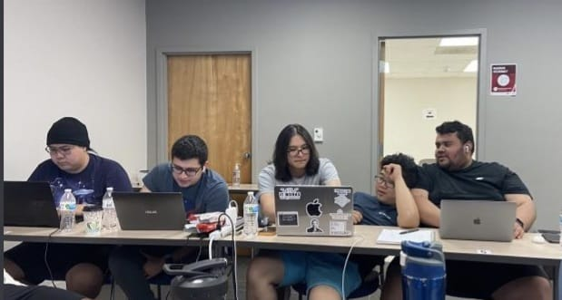


Thank You

Slide 23

Questions & Answers

